Slide 1
Angular 2: Worth to try
EPAM 2016, Aliaksei Habruseu

Slide 2
Angular 2: Improvements
Better performance
Easier to use
Future proof with ES6
Using web standards
Support for native mobile - iOS and Android (@View annotation)
Support for server side rendering
Improved testability

Slide 3
Biggest Changes
No default 2 way data binding
<input ngModel=“username” >

Slide 4
Biggest Changes
Typescript
Typescript will be default language

Slide 5
Biggest Changes
DI

Slide 6
Biggest Changes
No Controllers
Controllers? … What?
It’s time for components!

Slide 7

Biggest Changes
ES6 Modules
Angular2 is using ES6 modules

Slide 8
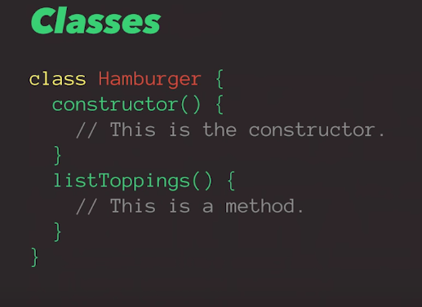
Classes
It all starts from the language support

Slide 9
Typescript
Typescript is a typed superset of JavaScript that compiles to plain JavaScript
Static checking and verification
Support ES6 (including decorators)

Slide 10
Typescript
function greeter(person) {
return "Hello, " + person;
}
var user = "Jane User";
document.body.innerHTML = greeter(user);

Slide 11
Typescript
function greeter(person: string) {
return "Hello, " + person;
}
var user = "Jane User";
=> somewhere in our code user = [1,2,3] -> failed static check
document.body.innerHTML = greeter(user);

Slide 12
Decorators
- Decorators are the functions that operate on a “target”
- “Targets” are classes, methods and properties
- Decorators invoked with a leading @ like @Component()

Slide 13
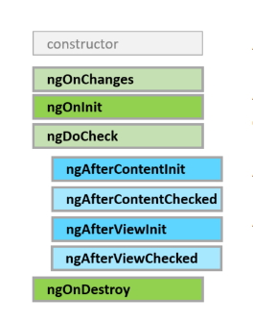
Lifecycle Hooks

Slide 14
Angular2: Structure
What we need to build Angular2 project?
CoreJS ES6 shim
Zones (ZoneJS) – detect data changes (bye $digest)
Reflect Metadata
SystemJS …. Webpack

Slide 15
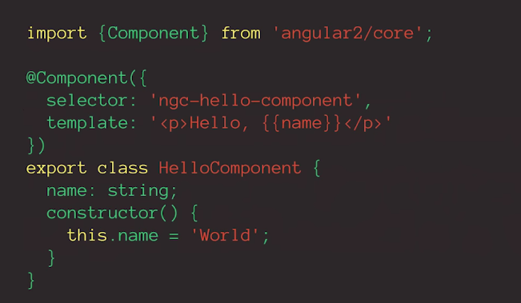
Components

Slide 16
Modules
Angular modules consolidate components, directives and pipes into block of functionality
Many Angular libraries are modules (like FormsModule, HttpModule etc)
An Angular module is a class decorated with @NgModule metadata
Every Angular app has at least one module class, the root module. We bootstrap that module to launch the application.

Slide 17
Template Syntax
{{ }} for interpolation - <h2>Total {{ totalCars }}</h2>
[] for property binding
ng-hide="isHidden“ => [hidden]="isHidden"
() for event binding
keyup)="onKey($event)"
# for variable declaration
<input type="text" #name> {{ name.value }}

Slide 18
Components Interaction
Pass data from parent to child with input binding
@Input decorations

Slide 19
Components Interaction
Intercept input property changes with a setter
Like standard defineProperty … get … set

Slide 20
Components Interaction
Intercept input property changes with ngOnChanges
Lifecycle Hook

Slide 21
Components Interaction
Parent listens for child event
@Output, EventEmitter

